Slide 1
Combinational Chips
Based on “The Elements of Computing Systems”, Nisan & Schocken, MIT Press, forthcoming in 2004, www.idc.ac.il/tecs
project 9
Yana Gabelev

Slide 2
Links
Project 9:
http://my.jce.ac.il/~arikgi/Web/Ex/Ex09/index.htm
EX09 zip :
http://my.jce.ac.il/~arikgi/Web/Ex/Ex09/Ex09.zip

Slide 3
Implementation
Implement all the following gates:
HalfAdder | Add16 | ALU | DivideInFour (twist)
FullAdder | Inc16 |  | Verification (twist)

Slide 4
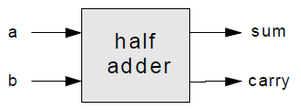
Half Adder
a b carry sum
0 0 0 0
0 1 0 1
1 0 0 1
1 1 1 0
Chip name: HalfAdder
Inputs: a, b
Outputs: sum, carry
Function: sum = LSB of a+b, carry = MSB of a+b
Notes:
carry = And(a, b)
sum = Xor(a, b)

Slide 5
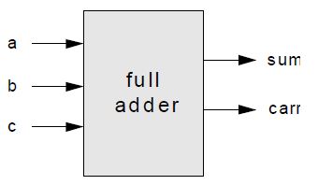
Full Adder
a b c carry sum
0 0 0 0 0
0 0 1 0 1
0 1 0 0 1
0 1 1 1 0
1 0 0 0 1
1 0 1 1 0
1 1 0 1 0
1 1 1 1 1
Chip name: FullAdder
Inputs: a, b, c
Outputs: sum, carry
Function: sum = LSB of a+b+c, carry = MSB of a+b+c
Notes:
sum = HalfAdder(HalfAdder(a, b), c)
carry = Or(carry1, carry2)

Slide 6
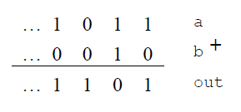
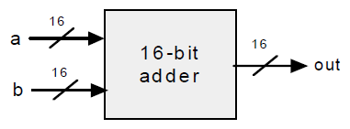
Add16
Chip name: Add16
Inputs: a[16], b[16]
Outputs: out[16]
Function: out=a+b
Comment: Integer 2's complement addition. Overflow is neither detected nor handled.
Notes:
out[0] = HalfAdder(a[0], b[0])
for out[1] to out[15]: FullAdder(a[i], b[i], carry[i-1])

Slide 7
Incrementer
It is convenient to have a special purpose chip dedicated to adding the constant 1 to a given number.
Chip name: Inc16
Inputs: in[16]
Outputs: out[16]
Function: out=in+1
Comment: Integer 2's complement addition. Overflow is neither detected nor handled.
Notes:
Use Add16

Slide 8
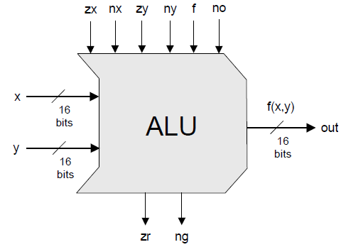
ALU (Arithmetic Logic Unit)
It is convenient to have a special purpose chip dedicated to adding the constant 1 to a given number.
Notes:
ALU = Add16 + And16 עם Mux

Slide 9
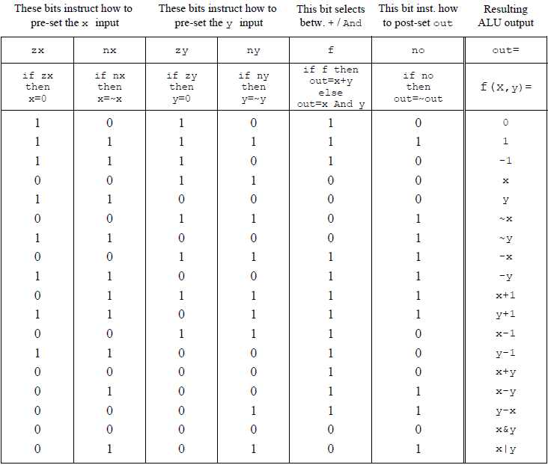
Notes:
הגדרה של פונקציה בוליאנית- קלט ופלט בביטים
$=2^{2^{n}}$ מספר פונקציות אפשריות כאשר n הוא מספר המשתנים
סה"כ יש 64 פונקציות אפשריות (לא חח"ע!)
למשל את D! אפשר ליצג בכמה דרכים: 001101 011100

Slide 10
Chip name: ALU
Inputs: x[16], y[16], // Two 16-bit data inputs
zx, // Zero the x input
nx, // Negate the x input
zy, // Zero the y input
ny, // Negate the y input
f, // Function code: 1 for Add, 0 for And
no // Negate the out output
Outputs: out[16], // 16-bit output (x+y)
zr, // True iff out=0
ng // True iff out<0
Function: if zx then x=0 // 16-bit zero constant
if nx then x=~x // Bit-wise negation
if zy then y=0 // 16-bit zero constant
if ny then y=~y // Bit-wise negation
if f then out=x+y // Integer 2's complement addition
else out=x&y // Bit-wise And
if no then out=~out // Bit-wise negation
if out=0 then zr=1 else zr=0 // 16-bit equality comparison
if out<0 then ng=1 else ng=0 // 2's-complement comparison
Comment: Overflow is neither detected nor handled.

Slide 11
Divide In Four
Chip name: DivideInFour
Inputs: in[16]
Outputs: a[16], b[16]
Function: a[16] is a 16-bit result of in/4
b[16] is the remainder - in modulo
Notes:
0100 ← shift → 0010
↕ ↕
4 2

Slide 12
Verification
This chip is ID verification.
In this ex you must write your 8-digit number in the first line of the README.txt.
It must contain only a 8 digit number, and no other character
Chip name: Verification
Inputs: in[16]
Outputs: verified, parity
Function: verified = returns 1 only if this number is the same as the last 4 digits of your ID (in a 16 bit binary representation)
parity = returns 1 if there is an odd number of 1's in the input, 0 otherwise

Slide 13
How and what to submit
Create a folder named 2015B_exXX_YYYYYYYY, when XX is the ex number, and YYYYYYYY is your ID.
For example: 2015B_ex09_123456789
All submission files should be in that folder, and no other extra file. Files to submit: HDL files, README.txt
Zip the folder to a zip file named 2015B_exXX_YYYYYYYY.zip

